Slide 1
Employee Data Analysis using Excel
STUDENT NAME: Y. MONICA
REGISTER NO: 422200158
DEPARTMENT: Bcom ISM
COLLEGE: Mohammed Sathak College of Arts and Science

Slide 2
PROJECT TITLE
Employee Performance Analysis using Excel

Slide 3


AGENDA
Problem Statement
Project Overview
End Users
Our Solution and Proposition
Dataset Description
Modelling Approach
Results and Discussion
Conclusion
3/21/2024 Annual Review

Slide 4

PROBLEM STATEMENT
"As a Human Resources Manager, I struggle to efficiently analyze and track employee performance across various departments and metrics. Our current process involves manual data collection, multiple spreadsheets, and tedious calculations."

Slide 5

PROJECT OVERVIEW
Develop an Excel-based dashboard to track and analyze employee performance across various departments and metrics, providing real-time insights for data-driven decision-making.

Slide 6

WHO ARE THE END USERS?
1. HR Managers: Responsible for tracking employee performance, identifying areas for improvement, and making data-driven decisions. 2. Department Heads: Supervisors and managers who oversee teams and need performance insights to optimize resource allocation. 3. Team Leads: Responsible for monitoring team performance, providing feedback, and coaching employees.

Slide 7

OUR SOLUTION AND ITS VALUE PROPOSITION
A comprehensive, user-friendly, and automated Excel dashboard that streamlines employee performance analysis, providing real-time insights for data-driven decision-making.

Slide 8
Dataset Description
A dataset description in Employee Performance Analysis using Excel is a detailed documentation of the data used to analyze employee performance. It includes: 1. Dataset Name 2. Description 3. Data Sources 4. Data Fields 5. Data Format 6. Data Frequency 7. Data Volume 8. Data Quality

Slide 9

THE "WOW" IN OUR SOLUTION
Automated, Real-time, and Actionable Insights" Our solution offers a unique combination of features that set it apart from traditional employee performance analysis methods 1. Automated Data Collection 2. Real-time Insights 3. Actionable Recommendations 4. Interactive Dashboards
3/21/2024 Annual Review
9

Slide 10
MODELLING
Modeling in Employee Performance Analysis using Excel refers to the process of creating mathematical representations of employee performance data to: 1. Predict future performance 2. Identify key drivers of performance 3. Develop targeted improvement strategies
10

Slide 11
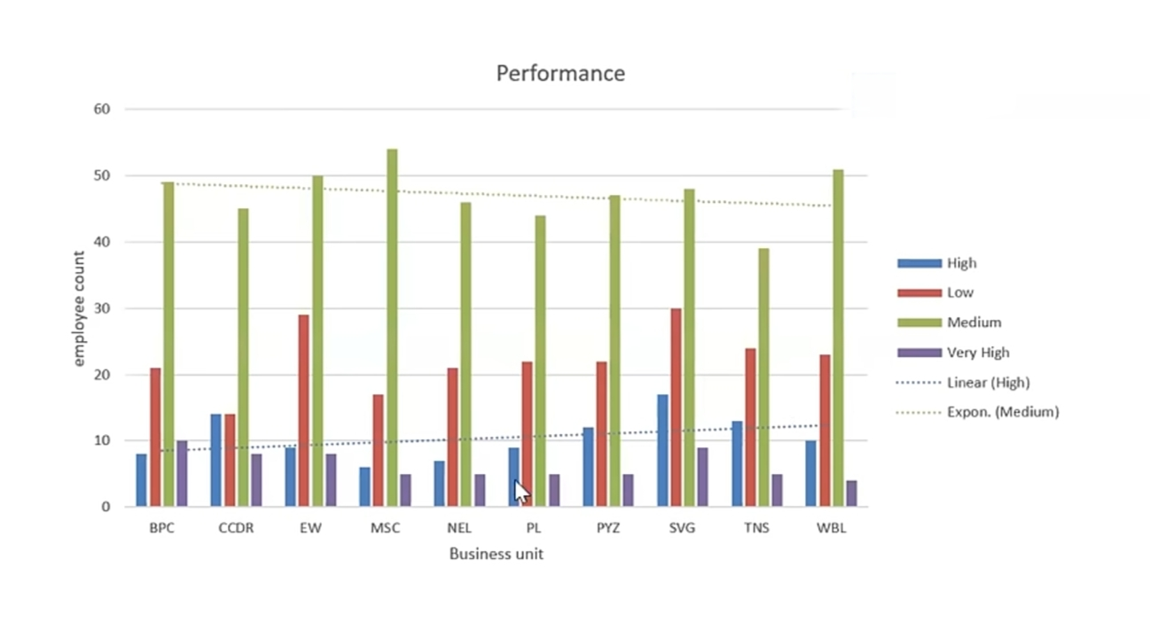
RESULTS
11

Slide 12
Conclusion
The conclusion in Employee Performance Analysis using Excel is the Final Summary of the insights and recommendations derived from the Analysis. It provides a clear and concise overview of the key findings and suggests actionable steps for improvement.
A Typical Conclusion may include:
Summary of key Findings, Recommendations for Improvement, Strategic Implication, Future Analysis, Limitations .

